Slide 1

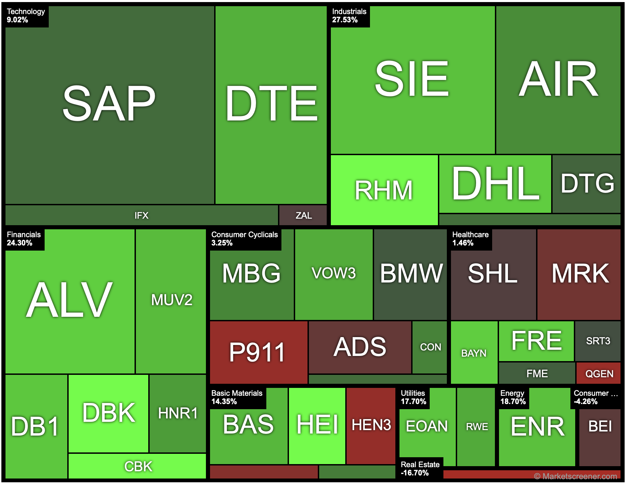
DAX Deutscher Aktienindex
Top 40 Blue Chip Stocks On the Frankfurt Stock Exchange
Time Series Analysis
H. M. Aquino
27 Mar 2025
https://uk.marketscreener.com/quote/index/DAX-7395/heatmap/
Notes:
Source: https://uk.marketscreener.com/quote/index/DAX-7395/heatmap/

Slide 2

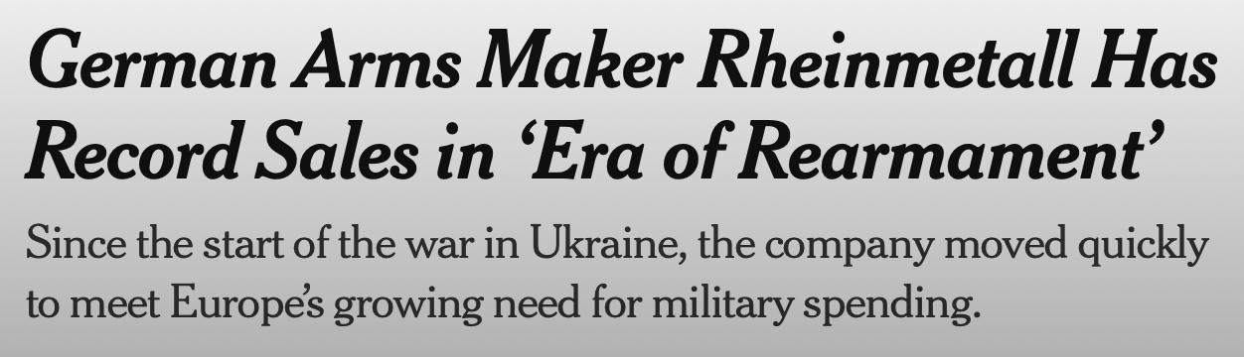
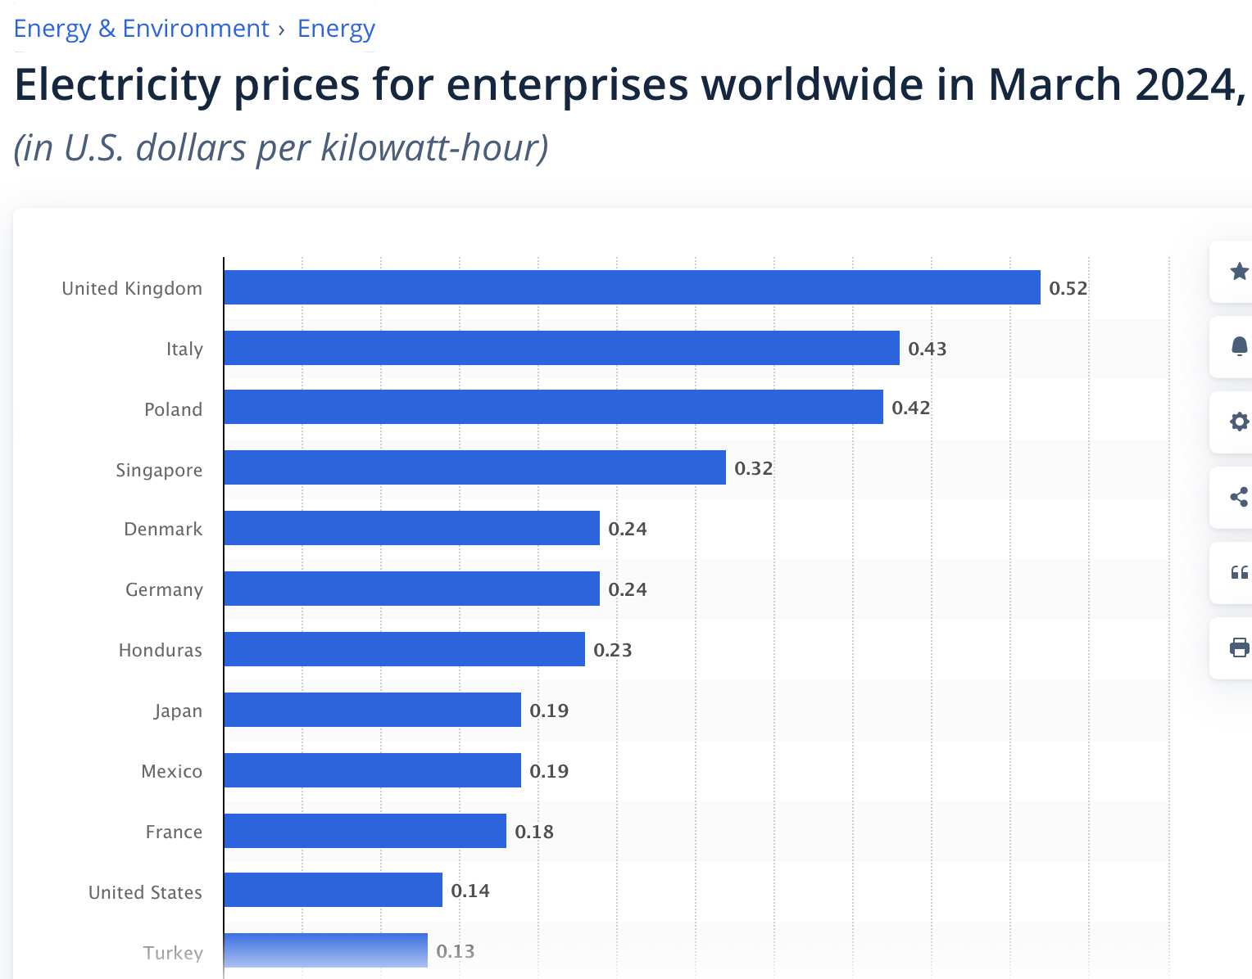


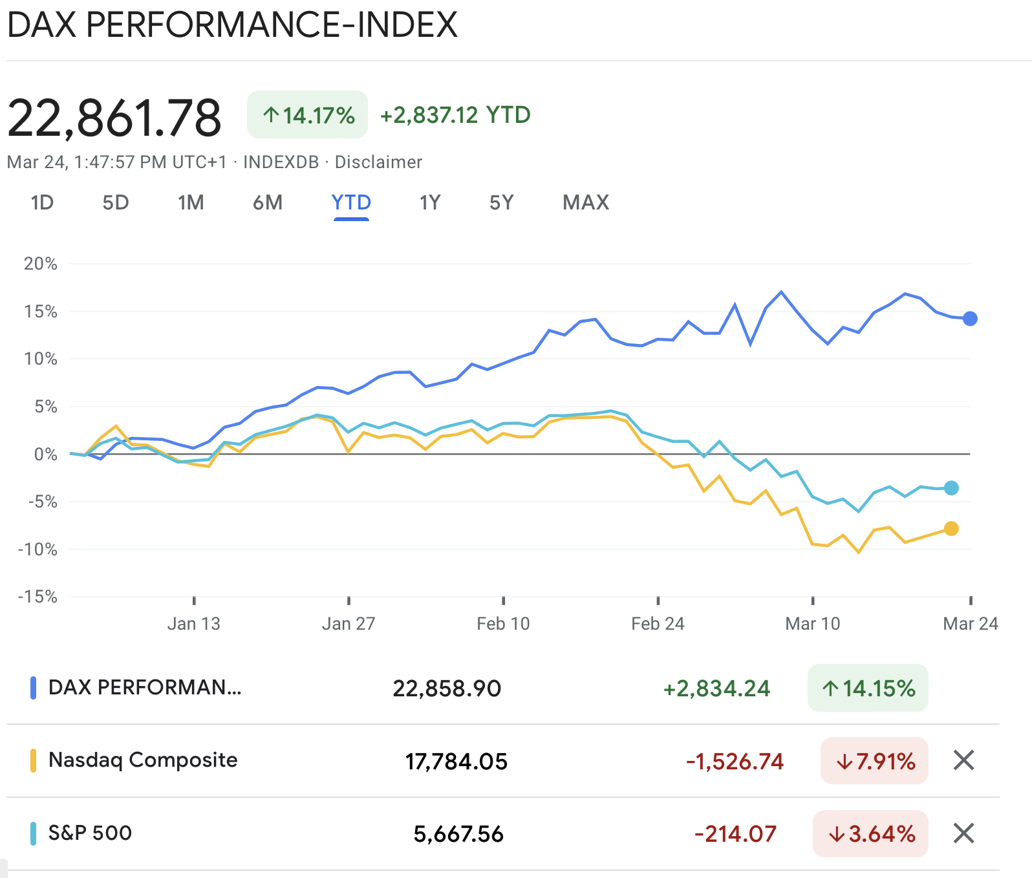

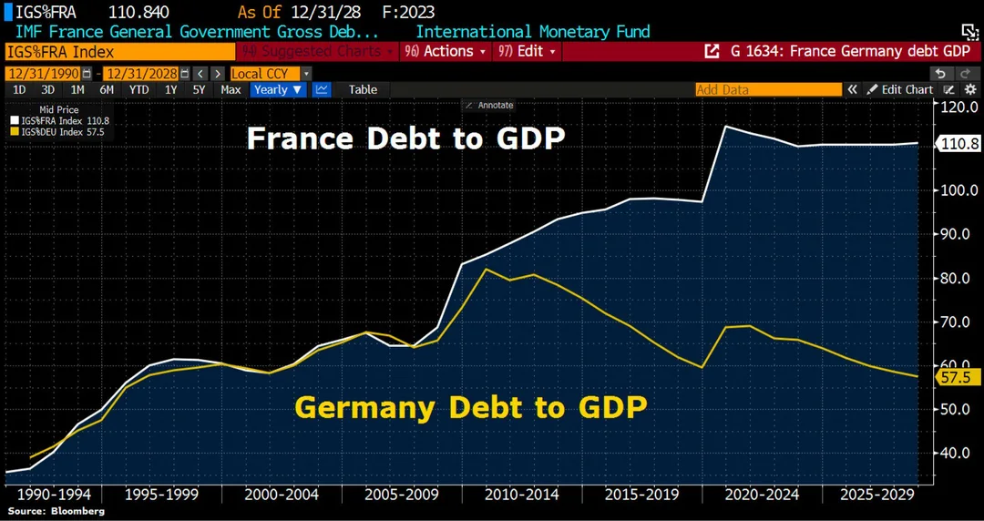
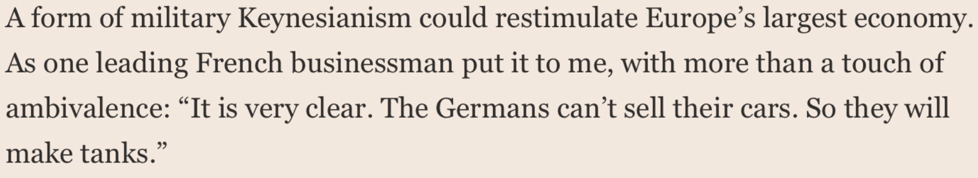
Why?
Notes:
Germany Debt-GDP ratio: 60% (lower than JP, US, China, UK, FR)
Source:
https://www.dw.com/en/china-puts-pressure-on-german-car-chemicals-engineering-industry/a-71919309
https://www.dw.com/en/1-trillion-impact-what-easing-debt-brake-means-for-germany/a-71949959
https://www.google.com/url?sa=t&source=web&rct=j&opi=89978449&url=https://www.ft.com/content/c02df9e1-10e0-4dfa-a3b5-0477cce3b98c&ved=2ahUKEwjr8ZHoh6aMAxV-WkEAHaHzB_sQFnoECBQQAQ&usg=AOvVaw1qlfNIcw95mmDsxyIffSa_
https://www.telegraph.co.uk/business/2025/03/11/volkswagen-open-to-building-military-equipment-german-army/
https://www.google.com/url?sa=t&source=web&rct=j&opi=89978449&url=https://www.ft.com/content/f4bb94b3-afba-4661-812b-bbba26d0f7ec&ved=2ahUKEwjm89_6h6aMAxXKV0EAHT91FvEQxfQBKAB6BAgREAE&usg=AOvVaw3CH3w2Xx8rcNVXPL05TLxc
https://www.nytimes.com/2025/03/12/business/europe-defense-rheinmetall-earnings.html
https://www.statista.com/statistics/1369634/business-electricity-price-worldwide-in-selected-countries/

Slide 3
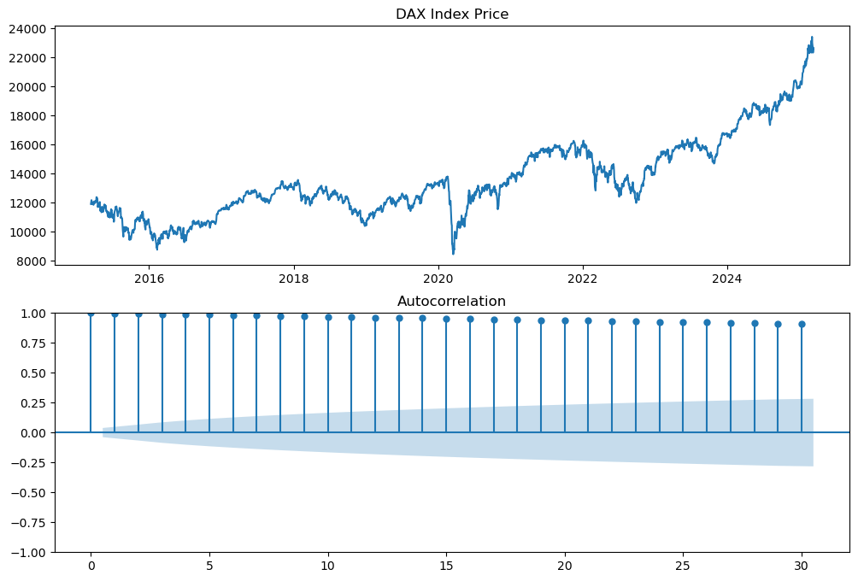
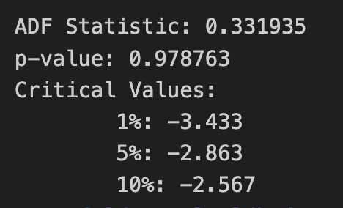
Data
10-year daily close price data (13 Mar 2015 - 2025) – uk.investing.com
2,589 observations
Cast data types (date & float)
Non-stationary data
Notes:
ADF stat > all critical values. P-value is higher than 0.05. Faill to reject Ho -> time series has a unit root and (non-stationary) does not have a constant mean & variance over time.
Source: https://uk.investing.com/indices/germany-30-historical-data

Slide 4
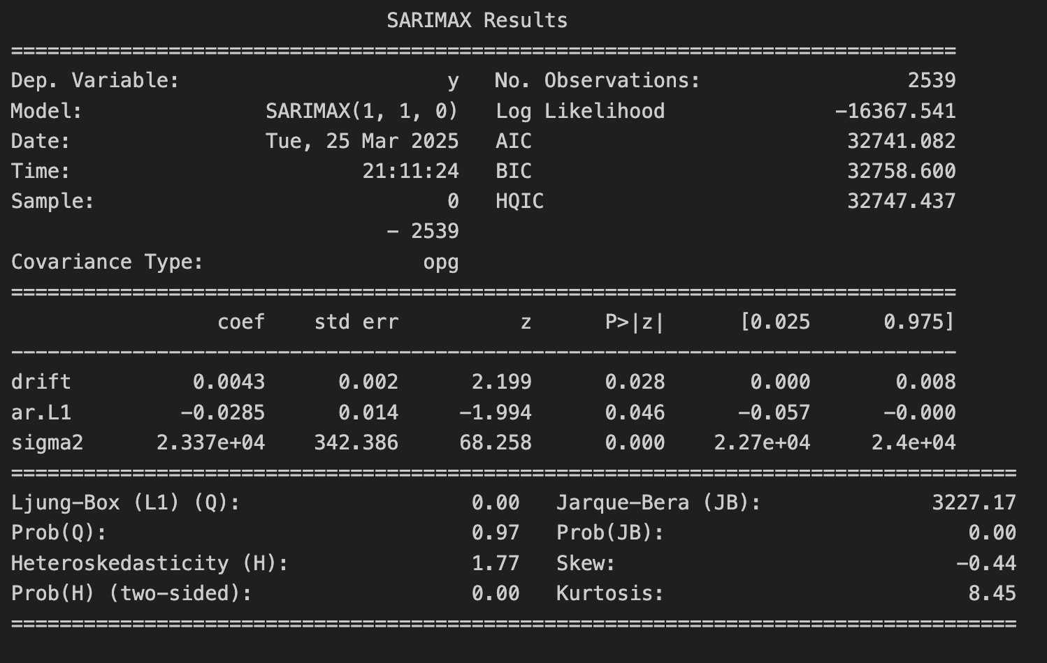
Method
First tried ARIMA(0,1,0) using differencing, ACF, & PACF plots. Changed because:
Seasonal patterns observed in the data.
Series affected by multiple trends (yearly cycles).
Series influenced by additional explanatory variables.
Result: Returning flat forecasts.
SARIMAX(1,1,0) is the best model. Captures trend and short-term autocorrelation.
Notes:
SARIMAX: Lowest AIC observed
No residual autocorrelation at lag 1.
Coefficient: -0.0285 (p=0.046), indicating weak negative autocorrelation at lag 1.
Sigma 2.337e+04 indicate high volatility in residuals
Ljung-Box Test (Lag 1): Q=0.00, p=0.97: No autocorrelation in residuals at lag 1
Jarque-Bera Test: JB=3227.17, p=0.00: Residuals are non-normal, with left skew (-0.44) and heavy tails (kurtosis=8.45)
Heteroskedasticity Test: H=1.77, p=0.00: Residual variance is non-constant over time (may need GARCH)

Slide 5
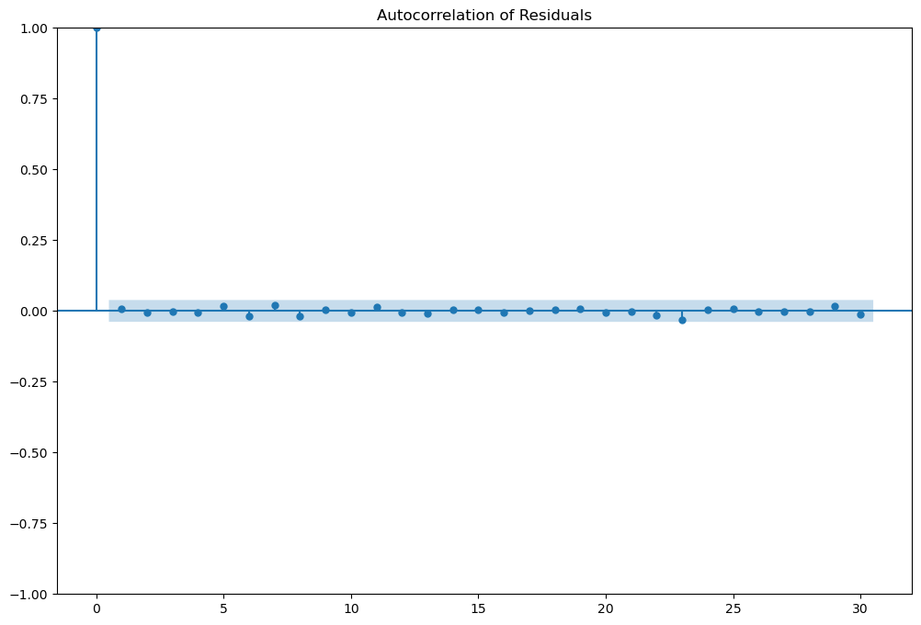
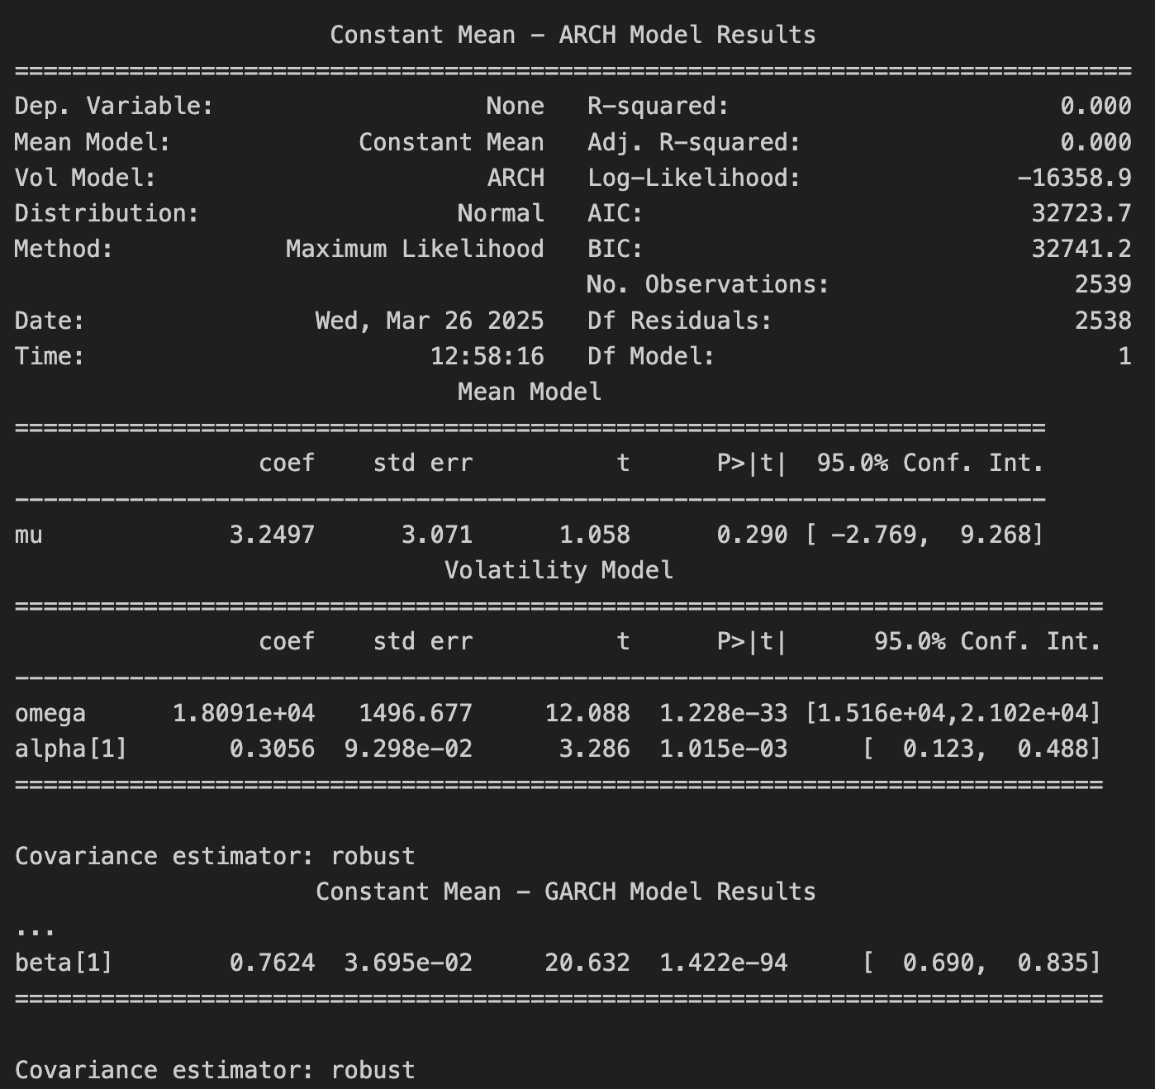
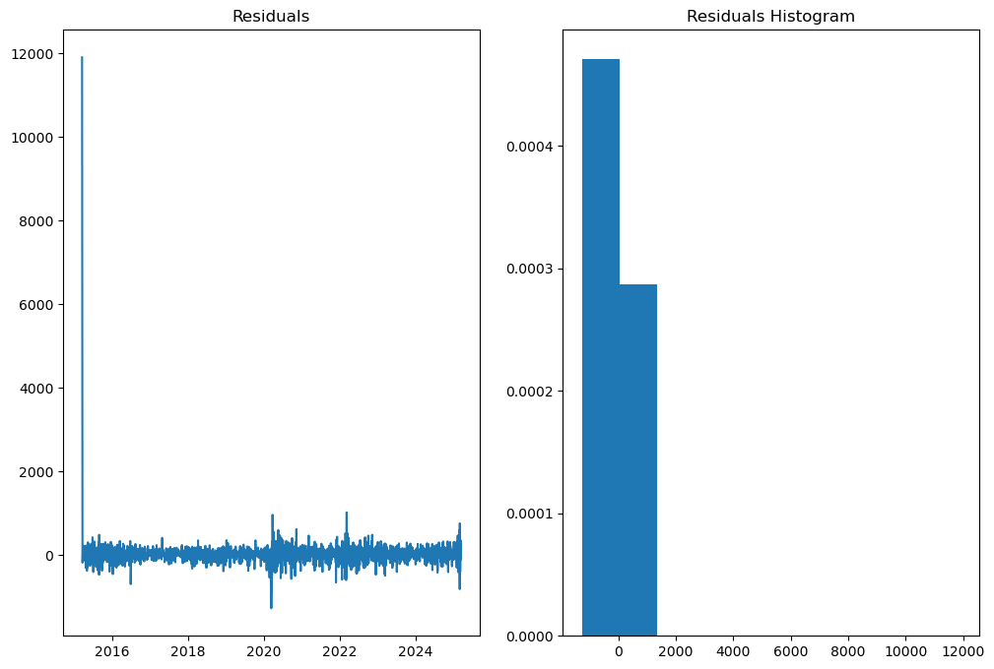
Method
Ljung-Box test for white noise
Ho: The residuals are independently distributed (i.e., no autocorrelation, white noise)
Lb Test statistic = 3.778801
Lb P-value = 0.956774
Residuals consistent with white noise (i.e., no autocorrelation)
Conclusion: Residuals appear random. Good sign for model diagnostics. Suggests model captured underlying structure of the data well, leaving only noise
ARCH found sufficient.
When doing GARCH, beta[1] found statistically zero, so the model effectively reduces to ARCH
Higher log likelihood for ARCH than GARCH’s
ARCH AIC & BIC was lower than GARCH’s
Model focuses on volatility (mu p=0.29) and captures time-varying volatility well (alpha[1] = 0.001)
Notes:
The model identifies strong volatility persistence (GARCH effect) and short-term reactions to shocks (ARCH effect), but the mean return is indistinguishable from zero. High omega indicates elevated baseline volatility.
Concise Interpretation of ARCH/GARCH Results:
Mean Model (Constant Mean):
The mean return (mu) is not statistically significant (p=0.29), suggesting no strong evidence of a non-zero average return.
The coefficient (3.2497) implies a small positive drift, but the wide confidence interval includes zero.
Volatility Model (ARCH/GARCH):
ARCH(1) Term (alpha[1]): 0.3056 (p=0.001) → Significant short-term volatility clustering (past shocks increase future volatility).
GARCH(1) Term (beta[1]): 0.7624 (p≈0) → High persistence in volatility (long-term memory effect).
Omega (Baseline Volatility): Very large (18,091), suggesting high unconditional volatility.
Model Fit:
Volatility dynamics are well-captured (significant ARCH/GARCH terms).

Slide 6
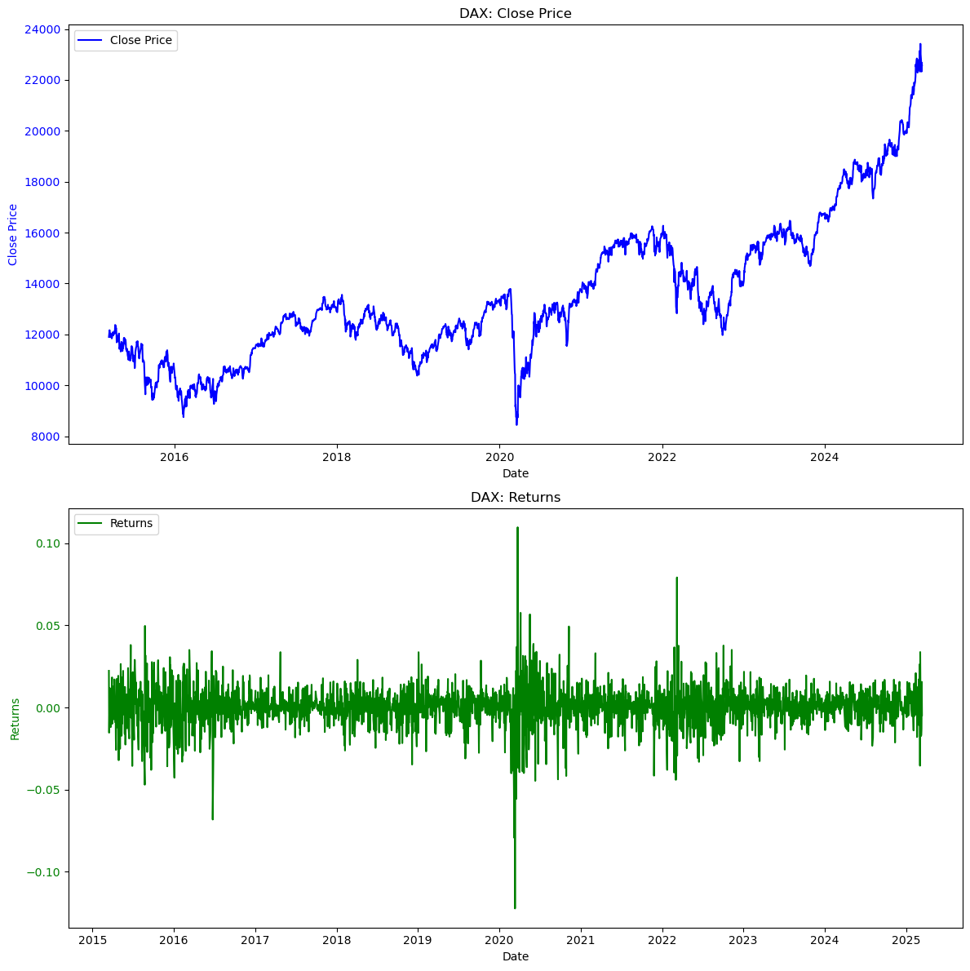
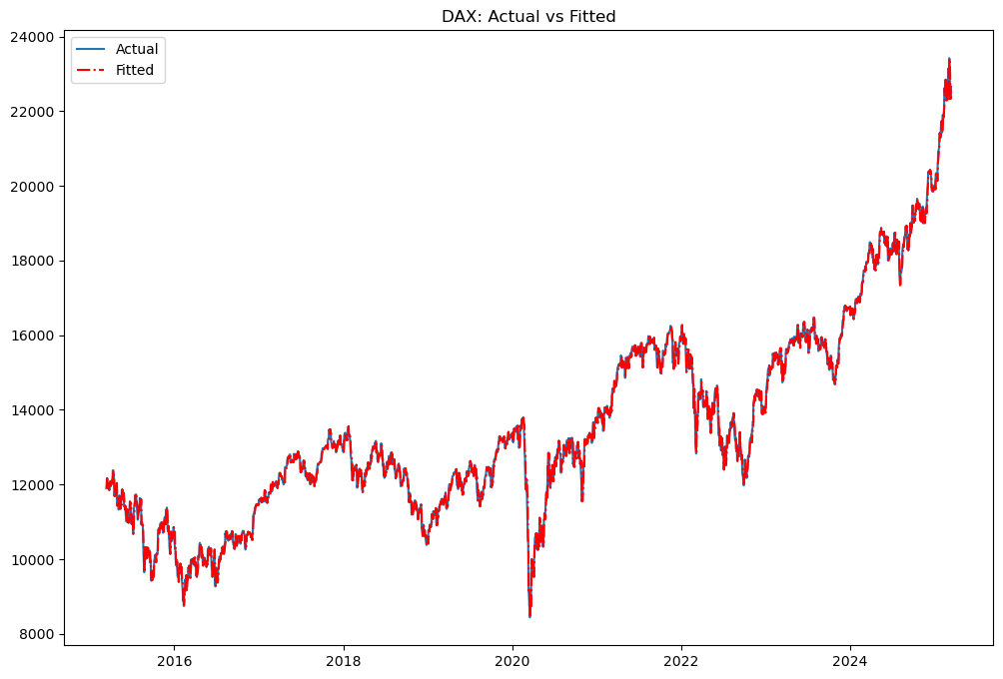
Method
Plot Fitted data vs Actual
Eyeball: looks reasonable

Slide 7
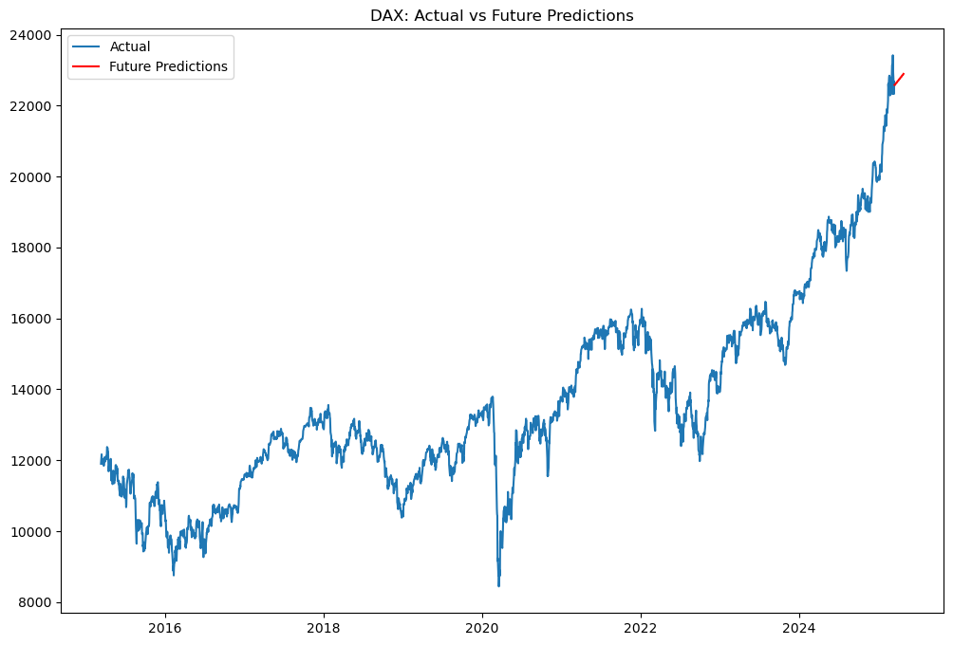
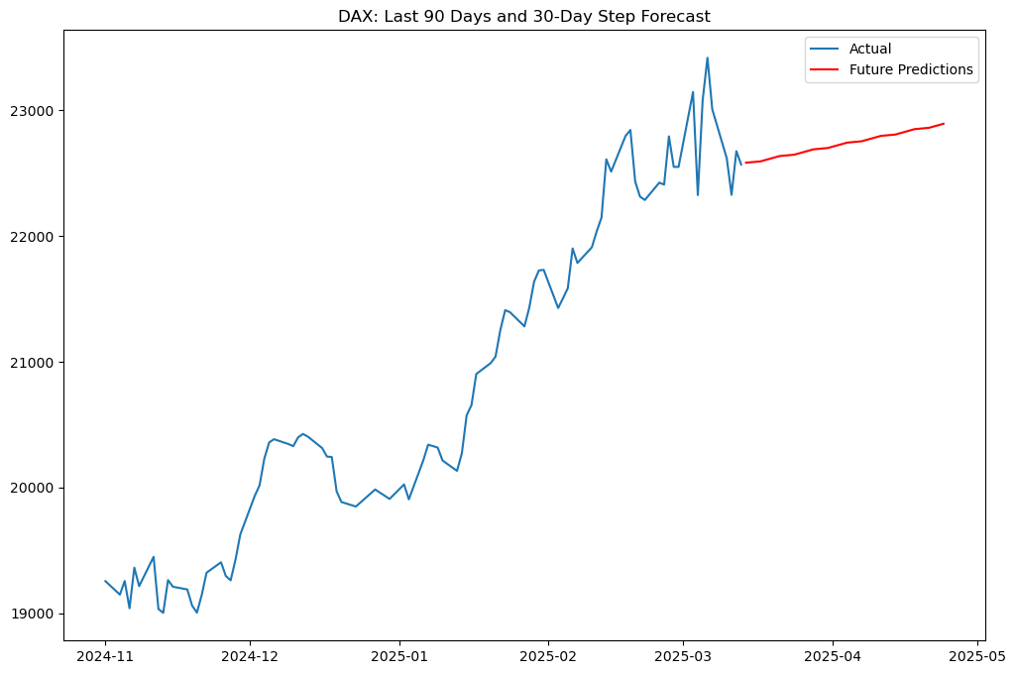
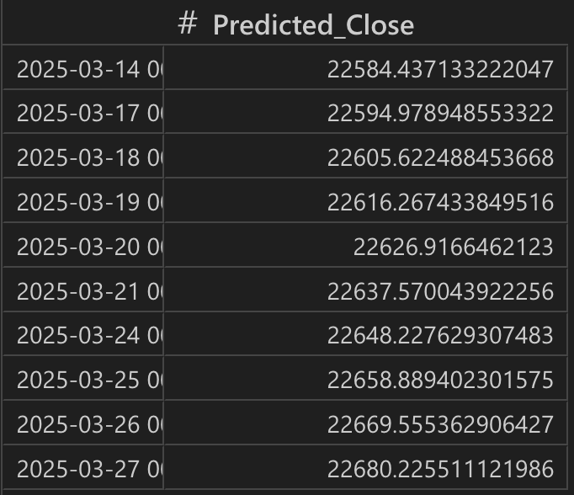
Results

Slide 8
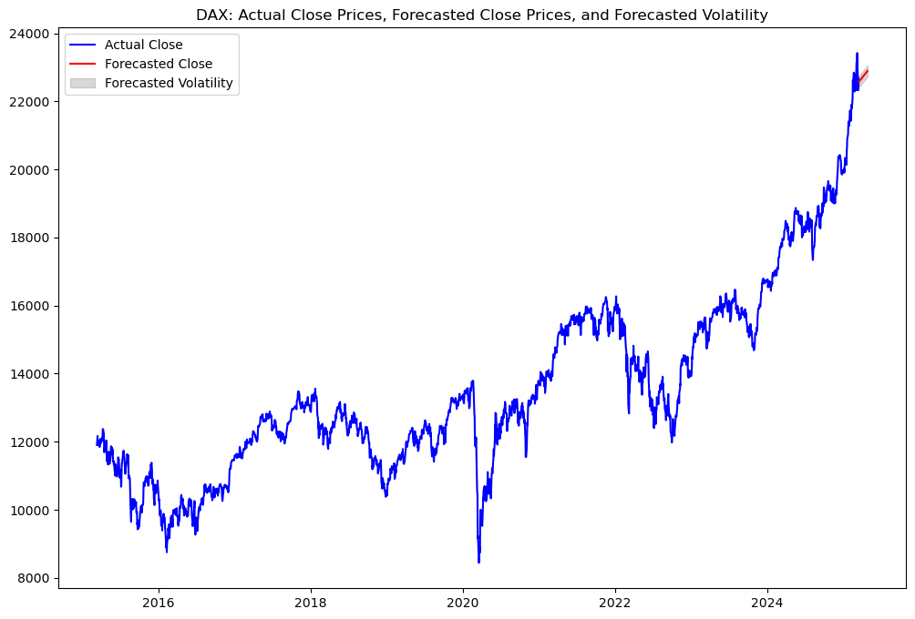
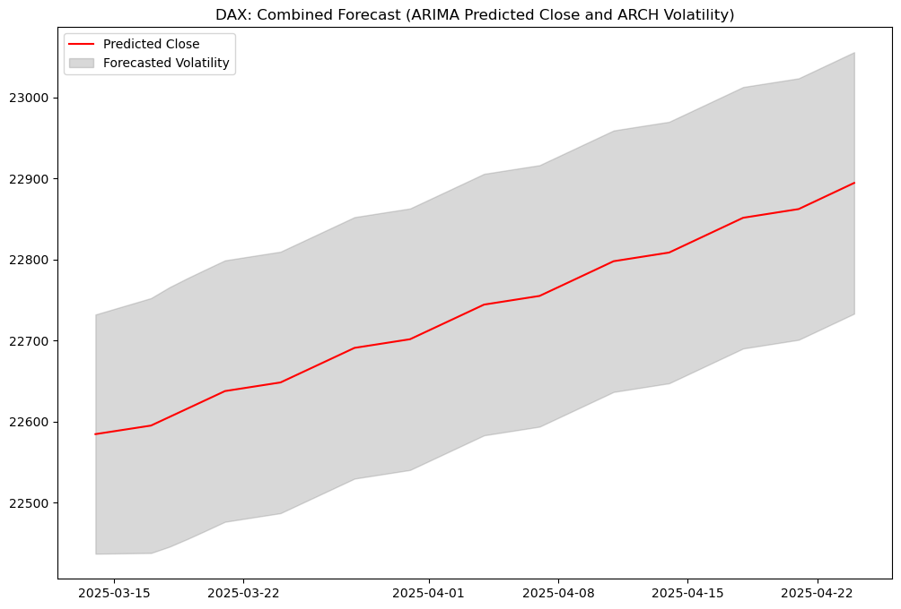
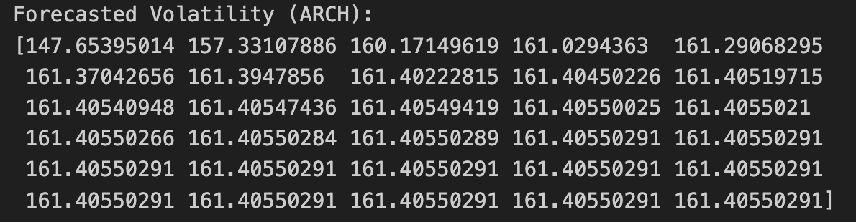
Results

Slide 9
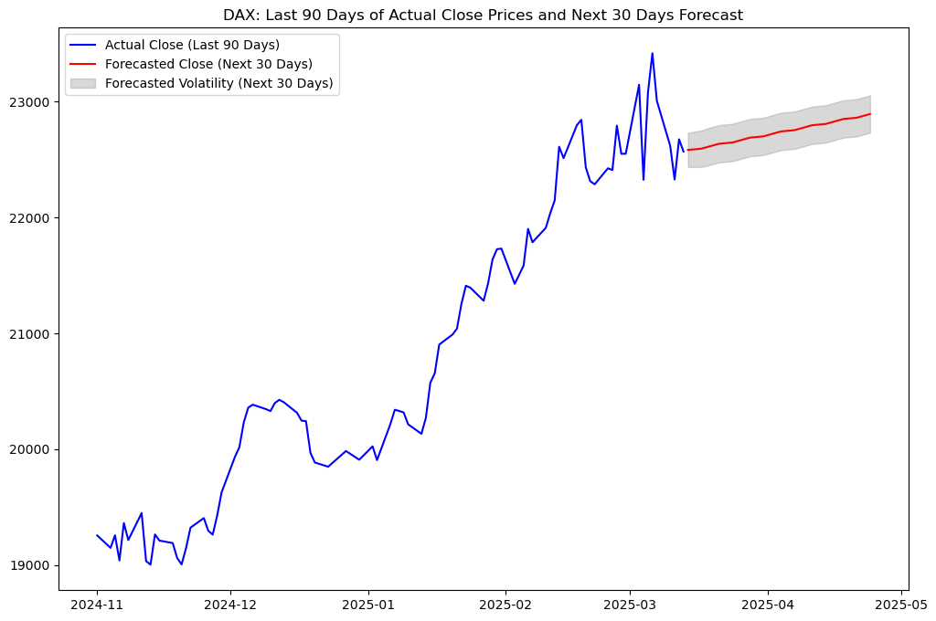
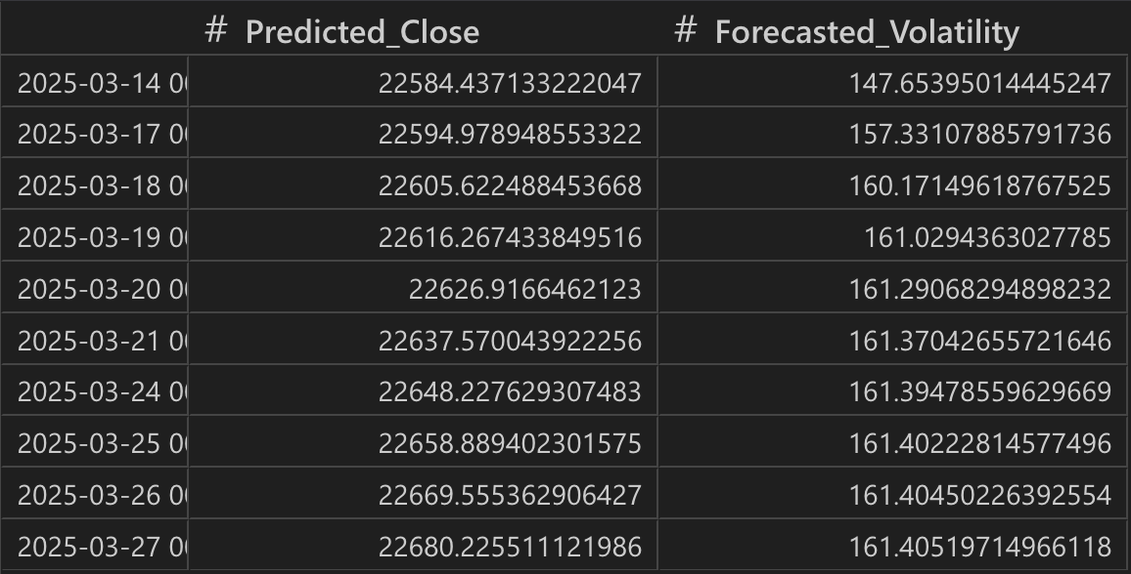
Results

Slide 10
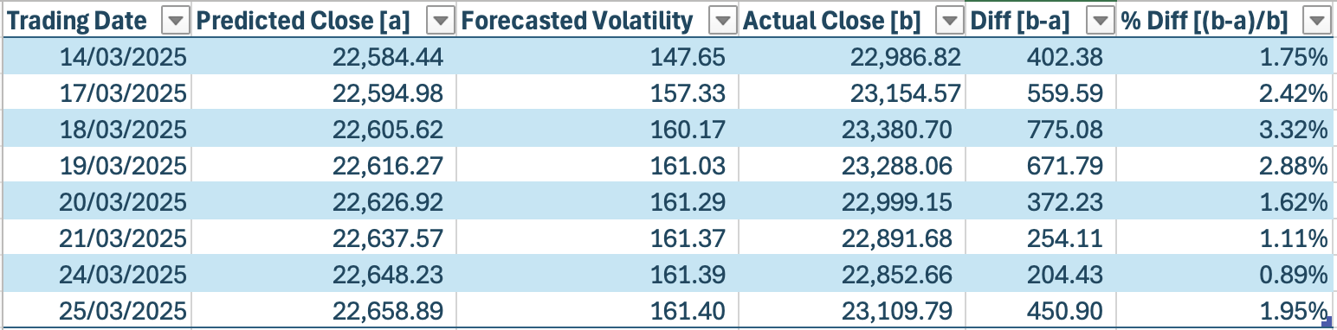

Conclusion
SARIMAX & ARCH models were effective in forecasting short term prices and volatility.
Limitations:
Only used close price data. Does not capture actual historical price movements (high/low) within the day.
Does not incorporate external variables.
Actual close prices: https://uk.investing.com/indices/germany-30-historical-data

